Slide 1
Lecture 6
Algorithm Analysis
Arne Kutzner
Hanyang University / Seoul Korea

Slide 2
Sorting Networks

Slide 3
Sorting Networks
Example of Parallel Algorithms
Not directly related to our classical “computer models” (e.g. Turing machines, von-Neumann architecture)
2016/10
Algorithm Analysis
L6.<number>

Slide 4
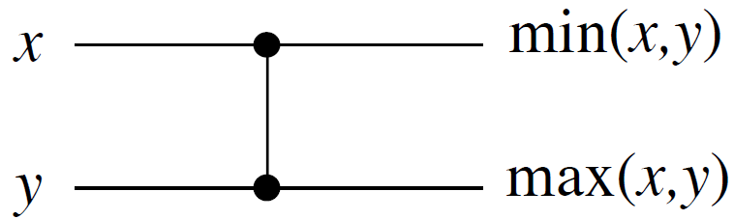
Comparator
wire
Input
wires
Output
wires
Works in O(1) time.
2016/10
Algorithm Analysis
L6.<number>

Slide 5
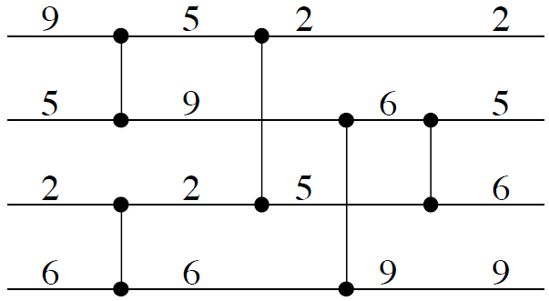
Example of Comparison Network
Input
Output
Wires go straight, left to right.
Each comparator has inputs/outputs on some pair of wires.
2016/10
Algorithm Analysis
L6.<number>

Slide 6
Correctness of Example Network
Claim that this comparison network will sort any set of 4 input values:
  After leftmost comparators, minimum is on either wire 1 (from top) or 3, maximum is on either wire 2 or 4.
  After next 2 comparators, minimum is on wire 1, maximum on wire 4.
  Last comparator gets correct values onto wires 2 and 3.
2016/10
Algorithm Analysis
L6.<number>

Slide 7
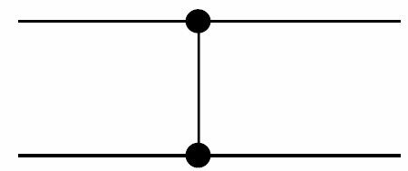
Definition of Depth
Depth of some Wire:
Input wires of the network have depth 0
Depth of a comparator := depth of its output wire
Depth of a Network := maximum depth of a an output wire of the network
Input depth: d_{x}
Output depth:
max (d_{x} ,d_{y}) + 1
Input depth: d_{y}
2016/10
Algorithm Analysis
L6.<number>

Slide 8
Depth - Example
Depth 1
Depth 2
Depth 3
2016/10
Algorithm Analysis
L6.<number>

Slide 9
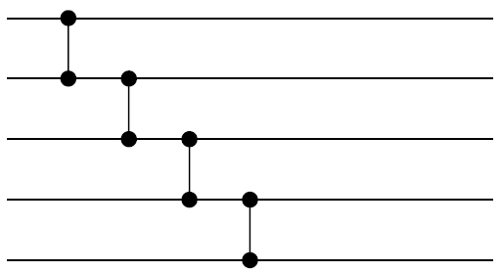
Selection Sorter
Foundation: Bouble-Sort Idea
Find the maximum of 5 values:
2016/10
Algorithm Analysis
L6.<number>

Slide 10
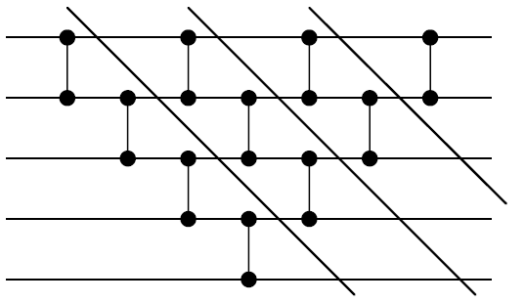
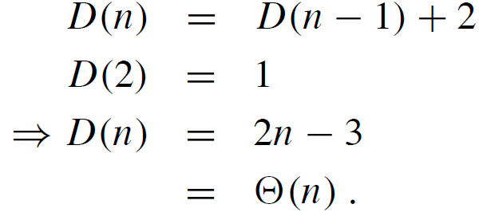
Selection Sorter (cont.)
We extend our idea:
Depth:
Selection Sorter for 4 elements
2016/10
Algorithm Analysis
L6.<number>

Slide 11
Zero-one principle
How can we test if a comparison network sorts?
  We could try all n! permutations of input.
  But we will see that we need to test only 2^{n} permutations.
Theorem (0-1 principle)
If a comparison network with n inputs sorts all 2^{n} sequences of 0.s and 1.s, then it sorts all sequences of arbitrary numbers.
2016/10
Algorithm Analysis
L6.<number>

Slide 12
Important Lemma
Lemma: If a comparison network transforms a = <a₁, a₂, . . . , a_{n}> into
b = <b₁, b₂, . . . , b_{n}>,
then for any monotonically increasing function f , it transforms
f(a) = <f(a₁), f(a₂), . . . , f(a_{n})> into
f(b) = <f(b₁), f(b₂), . . . , f(b_{m})>.
2016/10
Algorithm Analysis
L6.<number>

Slide 13
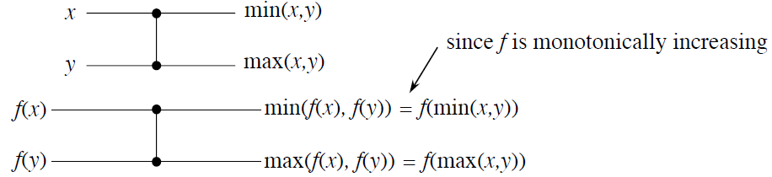
Proof of Lemma
Important property:
Then use induction on the depth of some wire
2016/10
Algorithm Analysis
L6.<number>

Slide 14
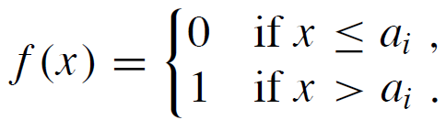
Proof of 0-1 principle
Suppose that the principle is not true, so that an n-input comparison network sorts all 0-1 sequences, but there is a sequence <a₁, a₂, . . . , a_{n}> such that a_{i} < a_{j} but a_{i} comes after a_{j} in the output.
Define the monotonically increasing function
2016/10
Algorithm Analysis
L6.<number>

Slide 15
Proof 0-1 principle (cont.)
By our lemma proven before:
If we give the input
<f(a₁), f(a₂), . . . , f(a_{n})>,
then in the output we will have
f(a_{i}) after f(a_{j})
But this results in an unsorted 0-1 sequence. A contradiction.
2016/10
Algorithm Analysis
L6.<number>

Slide 16
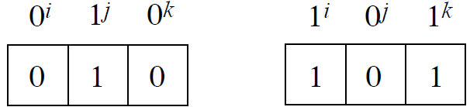
Definition of the notion “bitonic”
A sequence is bitonic if it monotonically increases, then monotonically decreases, or it can be circularly shifted to become so.
Examples: <1, 3, 7, 4, 2>, <6, 8, 3, 1, 2, 4>, <8, 7, 2, 1, 3, 5>
For 0-1 sequences bitonic sequences have the form:
2016/10
Algorithm Analysis
L6.<number>

Slide 17
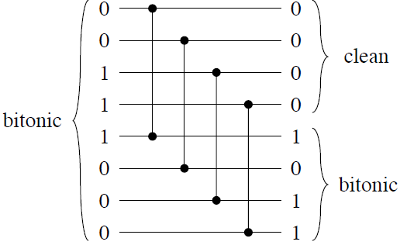
Half Cleaner
Comparison network of depth 1 in which input of line i is compared with line i+n/2 for i=1,2,…,n/2
2016/10
Algorithm Analysis
L6.<number>

Slide 18
Property of Half Cleaner
Lemma: If the input to a half-cleaner is a bitonic 0-1 sequence, then for the output:
  both the top and bottom half are bitonic,
  every element in the top half is ≤ every element in the bottom half, and
  at least one of the halves is clean.all 0.s or all 1.s.
Proof: Simple inspection of 8 different cases.
2016/10
Algorithm Analysis
L6.<number>

Slide 19
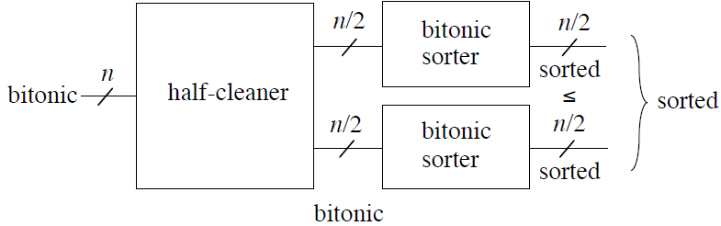
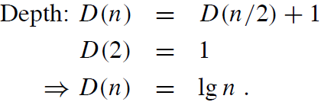
Bitonic Sorter
Recursively
defined, so we
have:
2016/10
Algorithm Analysis
L6.<number>

Slide 20
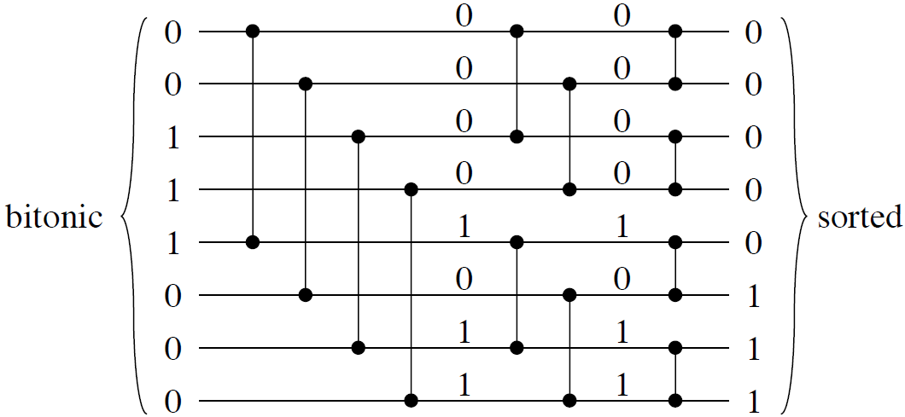
Example for bitonic Sorter
2016/10
Algorithm Analysis
L6.<number>

Slide 21
Merging Network
Idea: Given 2 sorted sequences, reverse the second one,
then concatenate with the first one ⇒ get a bitonic sequence.
Example:
X = 0011 Y = 0111 Y^{R} = 1110
XY^{R} = 00111110 (bitonic)
2016/10
Algorithm Analysis
L6.<number>

Slide 22
Merging Network (cont.)
How do we reverse Y? We don’t! Instead, we reverse the bottom half of the connections of the first half-cleaner:
X
X
is equal to
Y
Y^{R}
Y
2016/10
Algorithm Analysis
L6.<number>

Slide 23
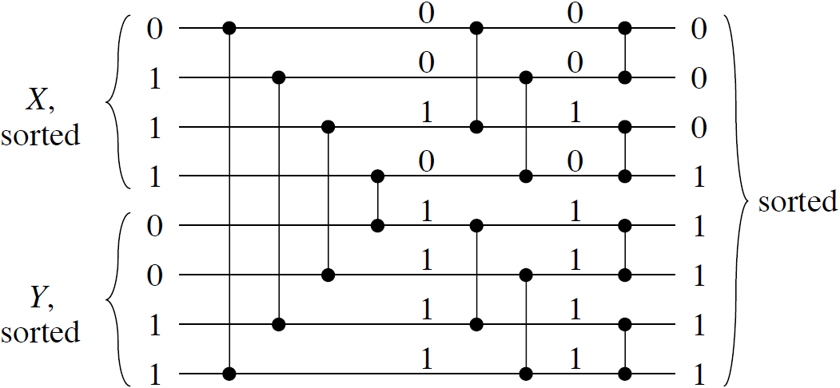
Merging Network - Example
So we get as Merging Network:
1
0
0
1
2016/10
Algorithm Analysis
L6.<number>

Slide 24
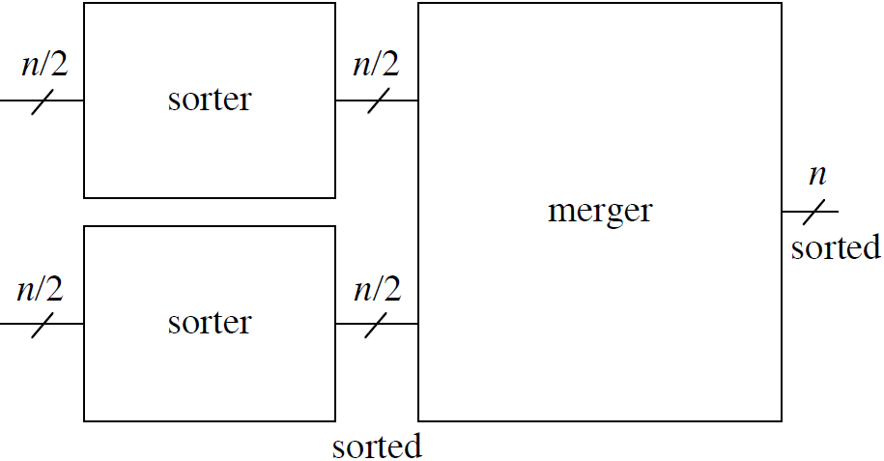
Sorting Network –
Construction Principle
Using the MergeSort-Idea we can recursively construct a Sorting Network by combining several Merger
2016/10
Algorithm Analysis
L6.<number>

Slide 25
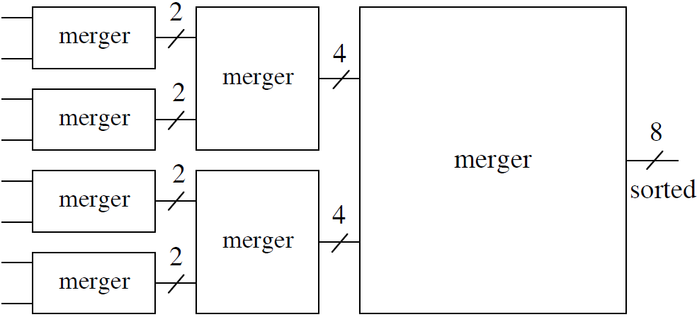
Sorting Network - Example
Example: n = 8
Sorter
Sorter
2016/10
Algorithm Analysis
L6.<number>

Slide 26
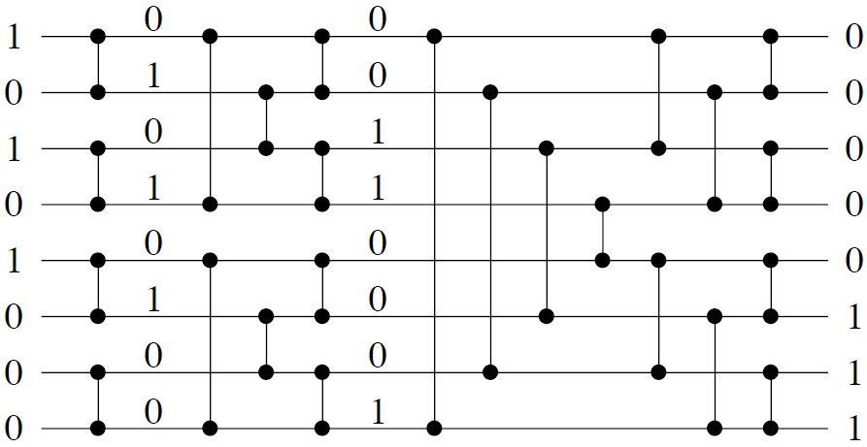
Sorting Network – Example (cont.)
Merger
Merger
Merger
2016/10
Algorithm Analysis
L6.<number>

Slide 27
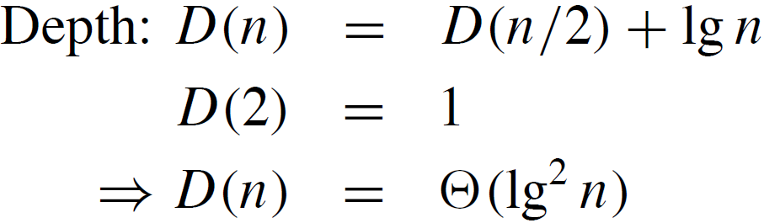
Sorting Network –
Complexity Analysis
According to the construction principle for sorting networks we get:
2016/10
Algorithm Analysis
L6.<number>

